Slide 1
First Day Information

Slide 2
Where am I?
PSYC 4703 – Research Methods
MWF 12:00pm – 12:50pm

Slide 3
Who is this person? (1)
Dr. Maxwell
Office hours: MW 1:00pm – 3:00pm; R 1:30pm – 2:30pm
Location: OD 118

Slide 4
Contacting Dr. Maxwell
How to contact me:
Email: nicholas.maxwell@msutexas.edu
  Please put course # and section # in header!
  24 – 48 hours (except on weekends)
Phone: ??? (don’t call me ☺)
In person!

Slide 5
Who is this person? (2)
Cognitive Psychologist:
  Memory!
  Language!
  How do these processes change with age?
  Research!

Slide 6
What do I get out of this Class?
An understanding of the research process, including how to think like a scientist, how to find research, and how to critically evaluate research
Ethical considerations for conducting research
Critical thinking and communication skills

Slide 7
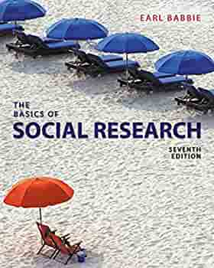
What will I Need?
Textbook: The Basics of Social Research, 7th Edition (Babbie, 2017)
Something to take notes with
Yourself (can’t learn if you don’t show up ☺)

Slide 8
What’s expected of you
Four Exams (100 points each)
Assignments (50 points total)
Class Participation (50 points)
  Can’t participate if you don’t show up…
Research Presentation (300 points)

Slide 9
Research Project
Propose a research study investigating a topic of interest
Detail the methods/significance/expected findings
Written component and 10-minute presentation!

Slide 10
Research Project!
Topics due: 1/30
4-6 page proposal due: 3/20
IRB application due: 4/21
Presentation Dates: 4/24 – End
Part of grade is attendance AND feedback during other presentations!

Slide 11
Important Dates
Exam 1 (2/6)
Research Topic (1/30)
Final (No final ☺)

Slide 12
Important Dates
Questions?
Comments?
Concerns?
Grievances?

Slide 13

What is “Research Methods”?
Psychology is an empirical science
  Advances made through rigorous research and testing
Research methods == tools psychologists use to answer questions about human behavior/mental processes
Can’t just rely on “intuition” or “claims”
  “Show me the data!”

Slide 14
Tips as we go through the semester
Critical thinking!
  Be a skeptic!
    Look for alternative explanations and contradictory evidence
  “It Depends”
    Behavior is rarely black or white (i.e., Men always act this way…)
Avoid all-or-none thinking
  Thinking in the extremes
  Be aware of your own biases

Slide 15
Tips for Success
Note-taking
  You are not a courtroom recorder, write the information in your own words to make it meaningful!
Reading
  Apply the information to a real-world example in your life
Study for exams
  Do not simply “review” the information, be engaged!
The “Illusion of Mastery”
  Can you actually “recollect” the material?

Slide 16
What’s next?
Complete the personality Assessment on D2L: *Due 1/20* @11:59
DO THE THING! http://www.mmlpsych.com/Methods/ (link is also on D2L)

